Slide 1
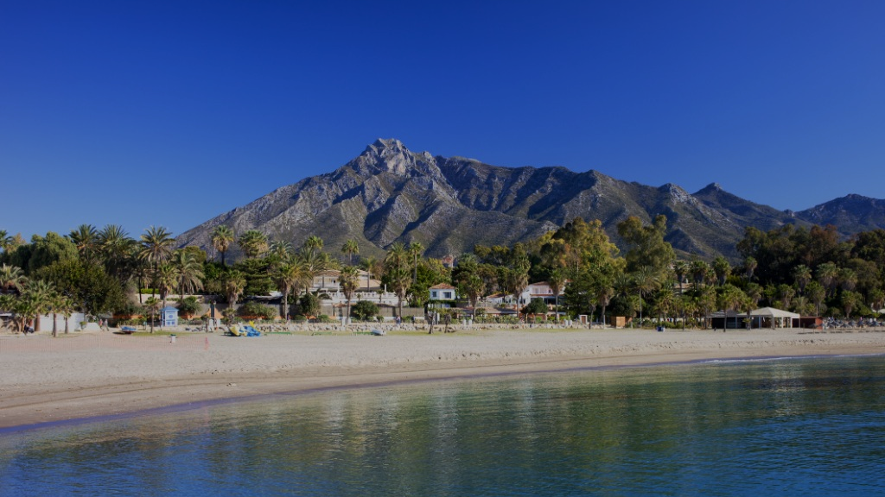
SAN SEBASTIAN
CULINARY ESCAPE
3 NIGHTS INCENTIVE PROGRAM

Slide 2
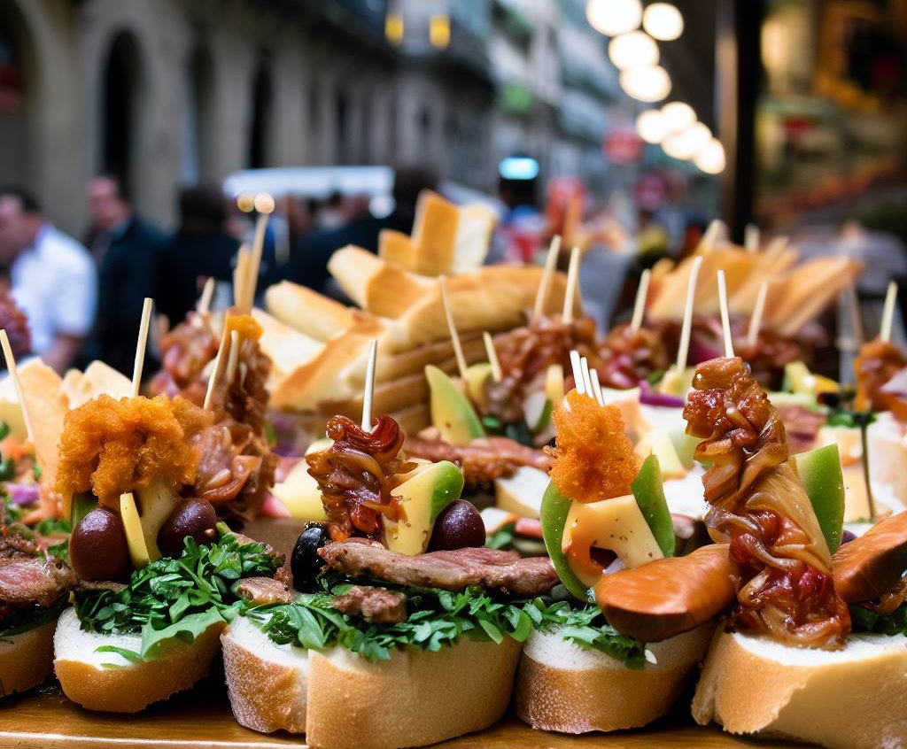
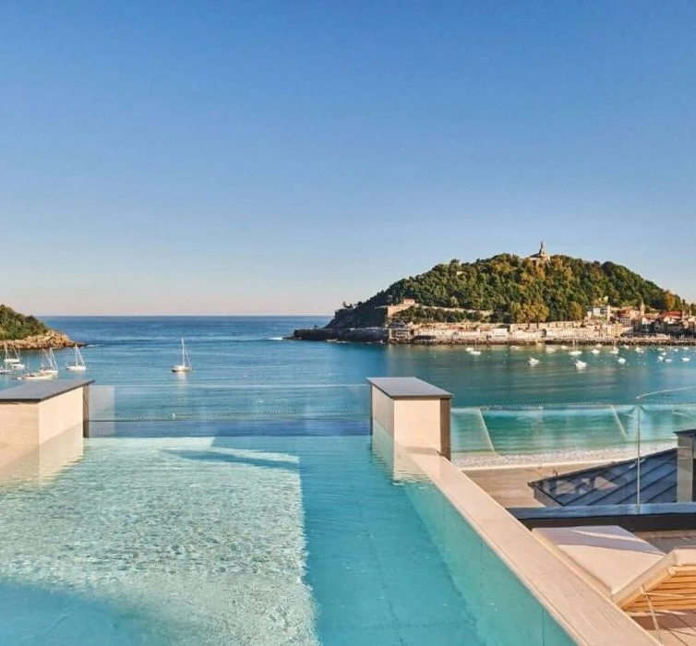
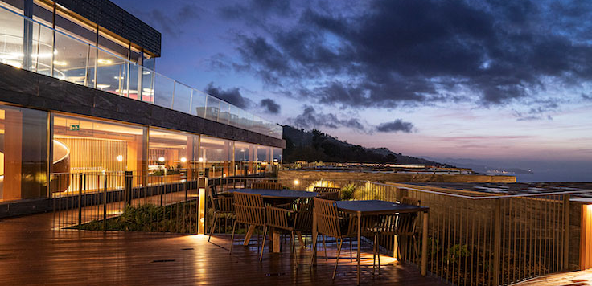
DAY 1: Arrival & Gastronomic Welcome!
Arrival in San Sebastián & Transfer to your hotel with sea view, where we will register for check in and leave the luggage, to embark right away on a private walking pintxos tour in the Old Town with expert local guides
Mid afternoon, we will get some free time to settle at the hotel, enjoy its swiming pool of the season ir right, or unwind from the trip with a stroll through the Bahia de la concha.
Welcome dinner will be held by the highest standards, with an exclusive Michelin-starred dinner for a world-class Basque culinary experience.

Slide 3
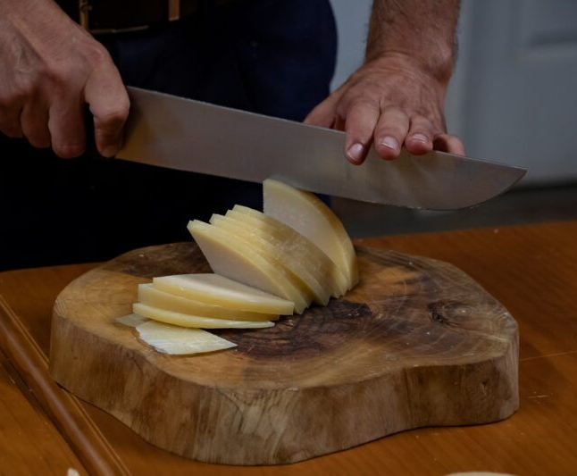
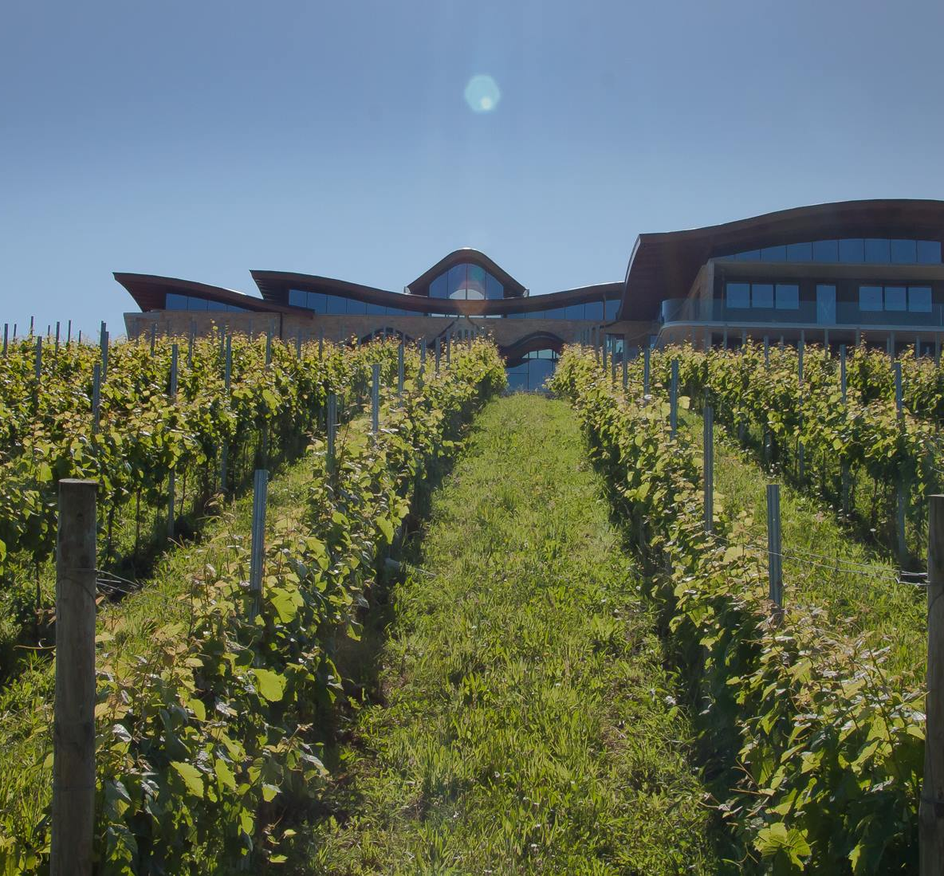
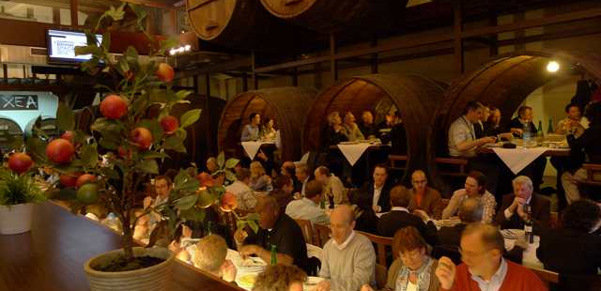
DAY 2: Basque Tradition – Cheese, Wine & sidrería experience
After breakfast, we will travel two hours through through the Basque countryside to reach Segura village, in the Goierri region, for a unique and authentic visit to a traditional Basque cheese factory. We will learn about the history and process of making Idiazabal cheese , taste the freshly made cheese and get an understanding the local Basque agricultural traditions
The next stop on our way back to the coast will be to discover another of Basque culinary jewels: the Txacoli, signature drink of the Basque Country, a unique and refreshing white wine. After a private tour of the cellar and some wine tasting, we will enjoy a wine pairing lunch, surrounded by the peaceful basque countryside landscape
The day will end with a relaxed dinner in a Traditional Sidrería (cider house) , featuring the famous grilled txuleta steak, tortilla de bacalao & cider straight from the barrel

Slide 4
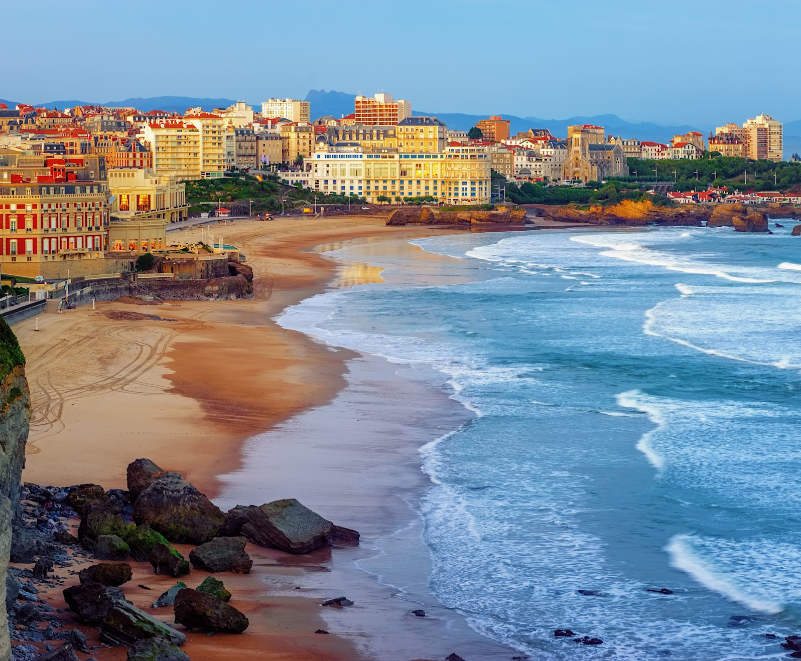
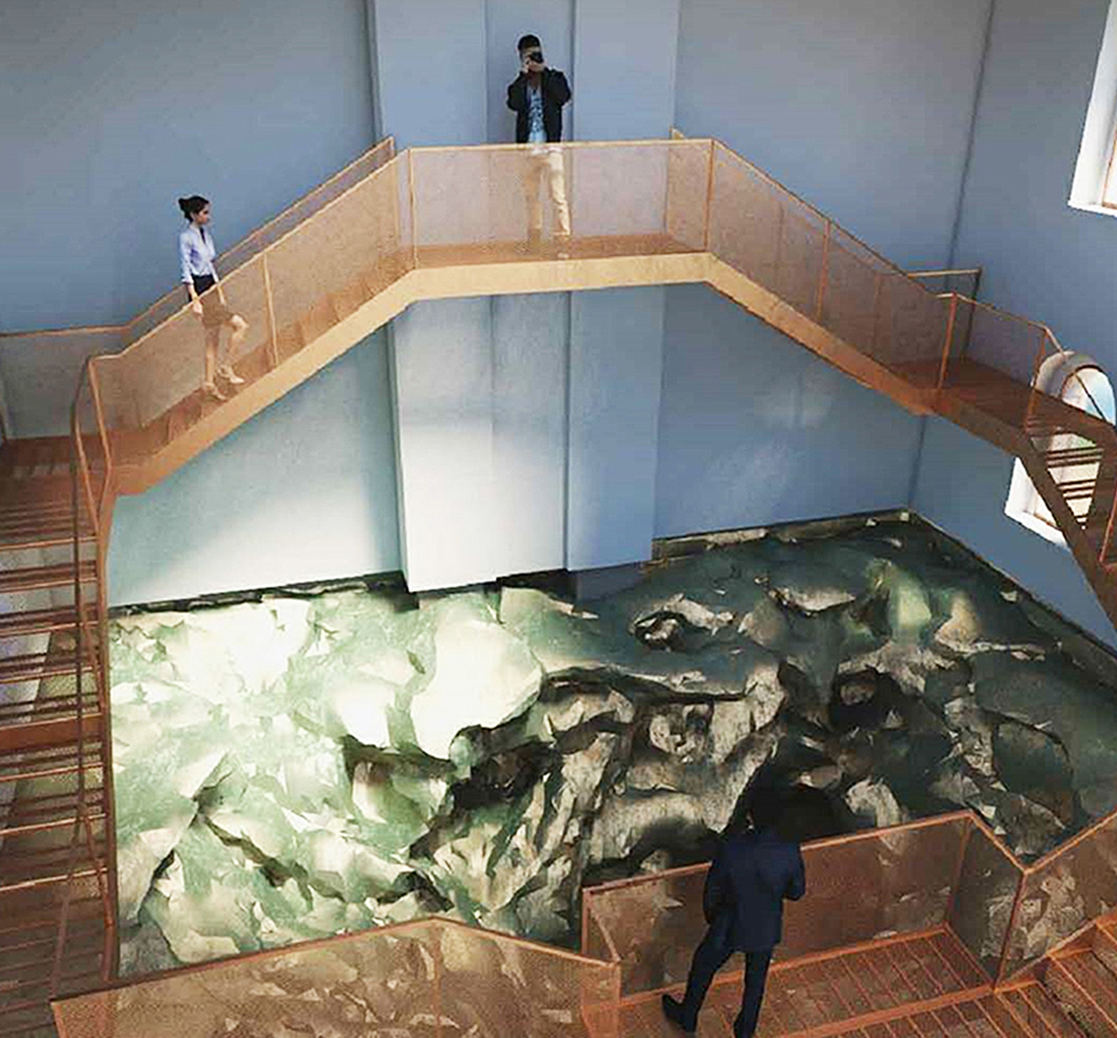
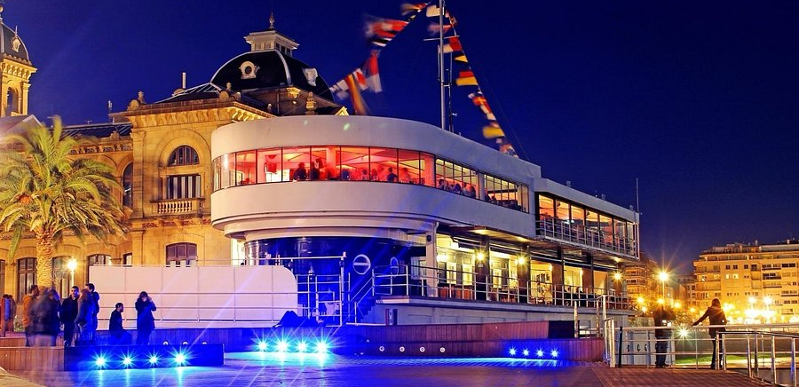
DAY 3: French Basque Coast & Island Adventure
Today will start with an excursion to the neighbour country! Within less than one hour drive, we will reach Biarritz, also Known as the "Pearl of the Basque Coast," this glamorous coastal town offers a unique blend of elegance, beauty, and surf culture. Next stop will be Saint Jean the luz, former Basque Corsairs’ capital. This small fishing village became rich in the 16th century from fishing and whaling. Piracy, added brought wealth to the town.
Back to Spain, our last stop of the excursion will be Hondarribia, where we will enjoy a scenic lunch with seaview
In San Sebastian, we will make the most of our afternoon taking a short sailing trip to Santa Clara island and it lighthouse. For many years, the Lighthouse of the Santa Klara Island in San Sebastian was empty and abandoned, until the sculptor Cristina Iglesias, transformed and restored its interior to convert it into a startling sculptural place. The fused geological strata and the water sequences transport the visitor to an experience in deep time.
For our last night, we will enjoy a gastronomic dinner in town,in a stylish venue with stunning bay views that turns into a nightclub at midnight, for those who feel like having a drink and party in their last night in town

Slide 5
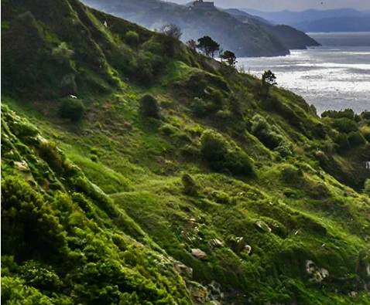
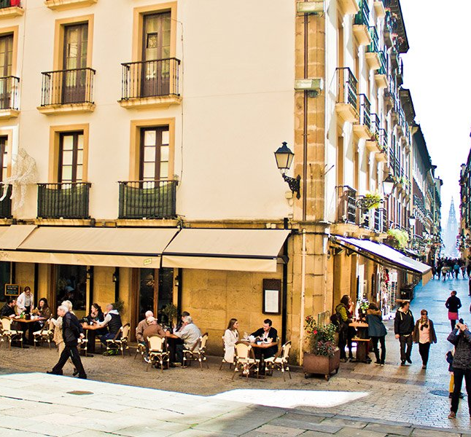
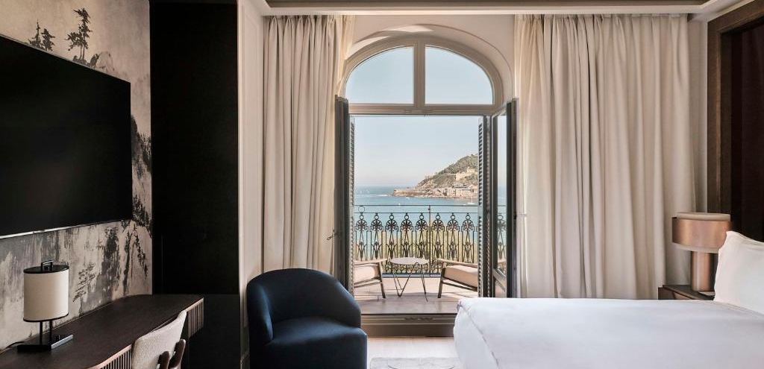
DAY 4: Adventure and departure
We will make to most of our last hours in San Sebastian, heading for an early morning 3hrs Hiking adventure along the coastal cliffs, offering breathtaking scenery
Back to the hotel, we will be just in time for a quick shower and check out before leaving for a nice and restoring Farewell lunch in local favorite restaurant.
Transfer from the restaurant to the airport
Tell us about your project and we will discuss the best options for your event, according to your budget and special needs.

